Slide 1
WARNING
These slides are not optimized for printing or exam preparation. These are for lecture delivery only.
These slides contain a lot of animations. For optimal results, watch in slideshow mode.

Slide 2
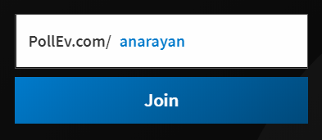
CS2113/T – Lecture 2
We are going to use the PollEverywhere for an in-lecture quiz.
Install the PollEverywhere app on your smartphone. Alternatively, you can submit responses at http://pollev.com/
Join the presentation http://pollev.com/anarayan
When prompted, use your NUSNET account to login
https://www.polleverywhere.com/mobile
This lecture will be recorded
This lecture will be recorded
Answer this question on PollEv.com:
I need advice and information on module matters (e.g., admin, grading, ...) [Choose the most appropriate]

Slide 3
Recap
Software engineering + module intro
Java introduction
RCS
IDE
Coding standards

Slide 4
(a) (b) (c)
switch (a) {
case 0:
doCase0();
break;
default:
doDefault();
break;
}
switch (a) {
case 0:
doCase0();
break;
default:
doDefault();
break;
}
switch (a) {
case 0:
doCase0();
break;
default:
doDefault();
break;
}
Activity: tweak your IDE to follow the style (b). Tip: search the Web to find out how
Today’s lecture will be activity-heavy!
Ideal: do all the activities (as instructed) on your own. If you get stuck:
Take note of where you got stuck
Ask in the forums [Use issue title: Lecture 2: … describe issue …]
Collectively we can try to solve the problem later

Slide 5
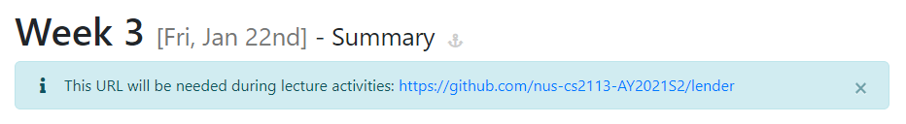
Activity: set up the Lender project
From Week 2:
Fork
Clone
Go to github.com/nus-cs2113-AY2021S2/lender
Fork to your GitHub account
Clone the fork to your computer
Set up the project in IDE (similar to how you set up iP)
Ckick OK on Zoom when you have set up the project

Slide 6
Activity: traverse the history
From Week 2:
Repository
Commit
Let’s traverse history using git
IDE Tip!
Install the presentation assistant plug in IntelliJ to view the keyboard short cuts when you do some operations.

Slide 7
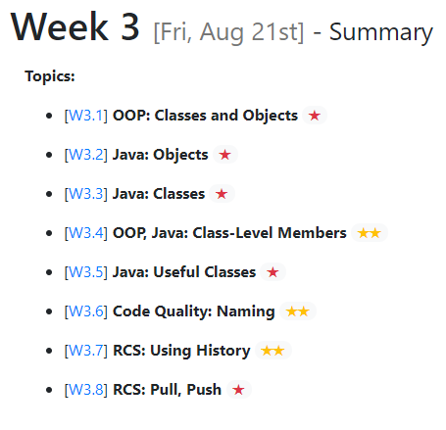
✔

Slide 8
Activity: traverse the history
Let’s traverse history using git
What if we want to track contact number of borrowers?

Slide 9

foo()
bar()
Main

Slide 10

Let’s follow real world
OBJECT-ORIENTED
OBJECT-ORIENTED
Object [ Data + related functions]
Structure solution as collaborating objects.

Slide 11
More details
Less details
X
function
function
Object
Object [ Data + related functions]
Data
Data
Data
function
Data
function
Data
function
Data
Object
Data
function
function
Data
Data
Data

Slide 12
Q: In the context of the discussion involving the Loan object, we are referring to:
Abstraction
Encapsulation
Object-orientation

Slide 13
Abstraction
More details
Less details
X
function
function
Object
Object [ Data + related functions]
Data
Data
Data
function
Data
function
Data
function
Data
Object
Data
function
function
Data
Data
Data

Slide 14
Encapsulates
Object [ Data + related functions]
f2
function1
data1
data2
function3

Slide 15
✔
✔

Slide 16
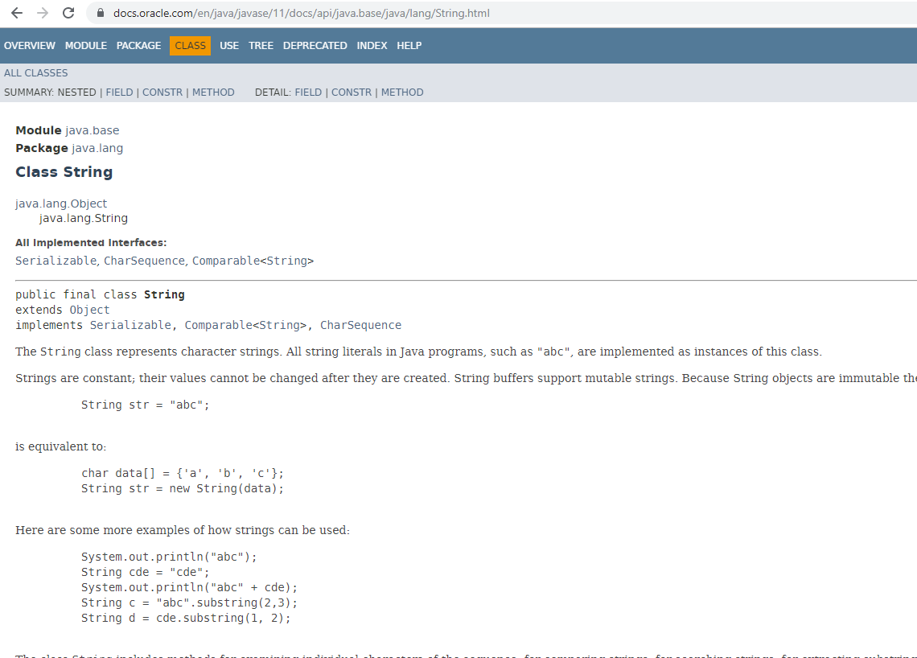
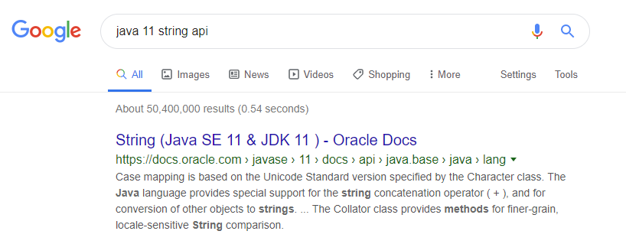
API = Application Programming Interface

Slide 17
✔
✔
✔
✔

Slide 18

Activity: introduce a Loan class

Slide 19
✔
✔
✔
✔
✔

Slide 20

Repo on remote server
Forked repo on GitHub
GitHub
fork
push
9. pull
push
clone
Local repo
Local repo
init
commit
Duke dev
You

Slide 21
Activity: pull
Add a new remote
pull

Slide 23
✔
✔
✔
✔
✔
✔

Slide 24
Activity: track max loan size

Slide 25
Q: The max loan size is a good candidate to be:
A statistic
A variable in LoanManager
A variable in Loan
None of the above

Slide 26
Activity: track max loan size
Class-level members

Slide 27
✔
✔
✔
✔
✔
✔
✔

Slide 28
Activity: commit, tag, push

Slide 29
✔
✔
✔
✔
✔
✔
✔

Slide 30
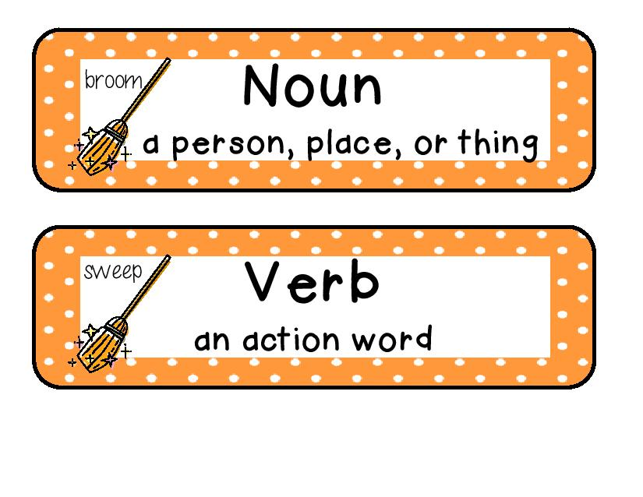
Naming
PascalCase
ClassName
camelCase
variableName
CONSTANT_NAME
Remember the 3 part format for tests!
doSomething()
doSomething_nothingToDo_throwsException()

Slide 31
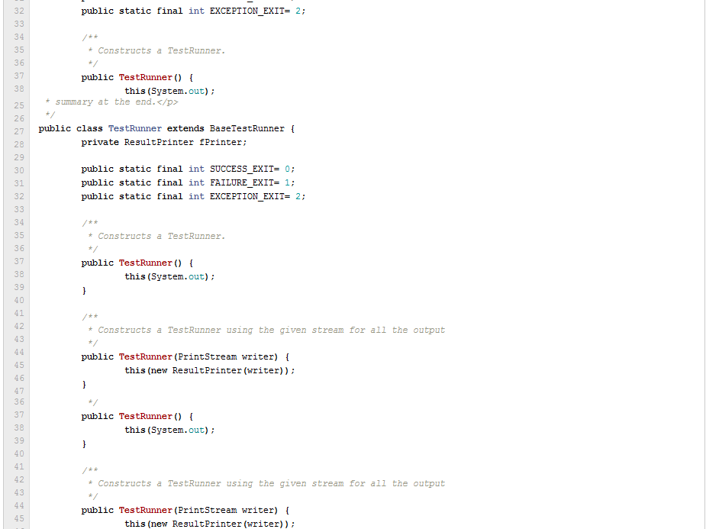
[extra] Junit code sample
EXIT_SUCCESS EXIT_FAILURE EXIT_EXCEPTION

Slide 32
Boolean flag;
vs
Boolean isValidResponse;
Related things should be named similarly
Name should explain the entity
String colorRed; // hex value of red
String colorBlue; // hex value of blue
String hexGreen; // hex value of green
int colorGreen; // num. times green is used
int redColorCount; // num. times red is used

Slide 33
✔
✔
✔
✔
✔
✔
✔
✔

Slide 34
Important
Reminder: read the topics, then do the exercises, then do the project increments.
Any problem? ask in the forum.
Deadline for iP:
Midnight before your tutorial

Slide 35
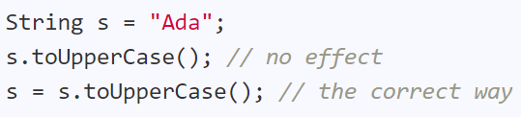
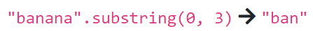
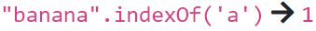
String class
Strings are immutable. String operations that look like changing the string actually return a new string.

Slide 36
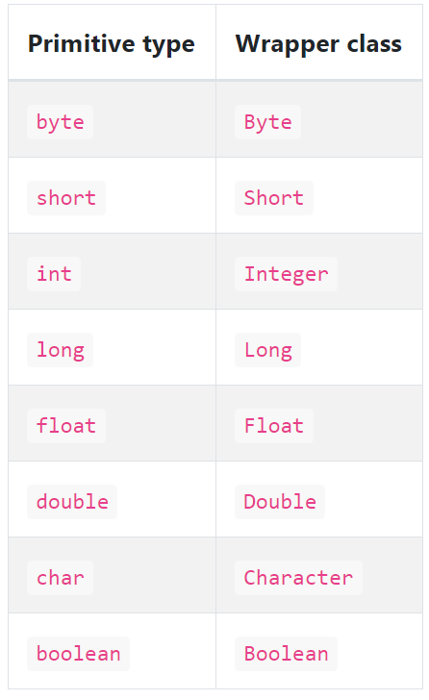
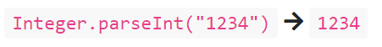
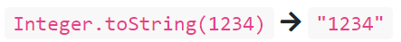
Wrapper classes
OOP expects everything to be an object. But Java uses primitive data types (they are not objects!) because primitives can perform better than objects
Corresponding Objects (called Wrapper classes) can be used when needed.

Slide 37
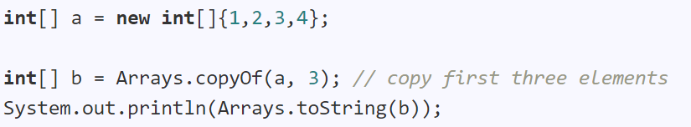
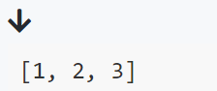
Arrays class

Slide 38
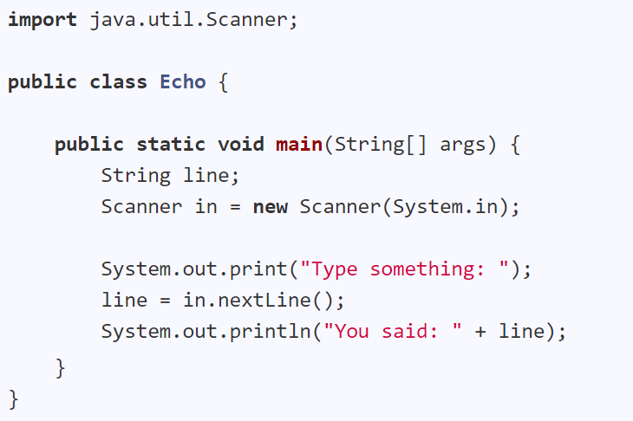
Scanner class

